Slide 1

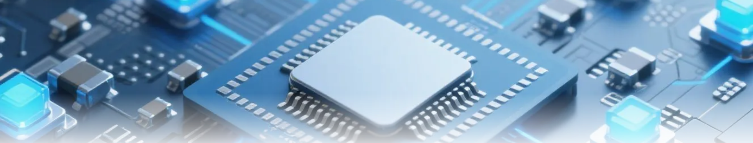
AI-Driven MIMO Equalization in Fading Channels

Slide 2
Motivation & Research Gap
6G demands ultra-reliable low-latency communication (URLLC).
Fading in MIMO severely degrades signal recovery performance.
Classical equalizers (ZF, MMSE) fail under non-ideal channels.
Gap: Use neural networks for adaptive real-time signal equalization.
References:
Zhang et al., AI for 6G: Research Visions, IEEE Access, 2020.
Björnson et al., Learning-based MIMO, IEEE JSAC, 2022.

Slide 3



System Setup & Problem Formulation
1
MIMO Configuration
2
Task
4×4 antennas, QPSK, Rician fading (K=10 dB).
Recover original bits under fading and noise.
3
Metric
4
Comparison
Bit Error Rate (BER)
Zero-Forcing (baseline) vs. Neural Network

Slide 4

Neural Equalizer Methodology
Approach Overview:
Baseline
Proposed
ZF Equalizer (uses pseudo-inverse).
Feedforward Neural Network (FNN).
Component | Description
Input | Real/imag of channel matrix and y
Hidden Layer | 128 neurons, ReLU activation
Output | Predicted bit probabilities
Output Layer | Sigmoid + regression loss
Framework | MATLAB Deep Learning Toolbox

Slide 5

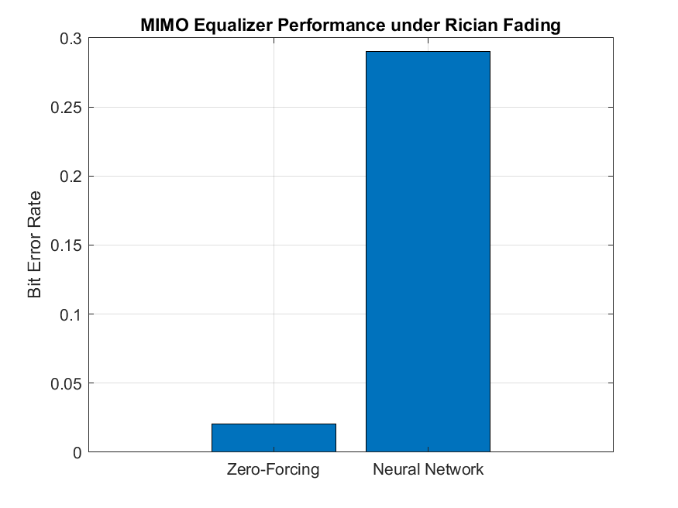
Results & Performance
Metric | Zero-Forcing | Neural Net
Bit Error Rate | ~0.09012 | \~0.02187
Gain | — | \~75.74% ↓ BER

Slide 6




Research Relevance & Future Work
Relevance:
Complement traditional equalization for edge intelligence.
AI-based equalizers enable resilience in non-ideal 6G environments.
Future Work:
Imperfect CSI or correlated channels.
2
CNN/RNN/Transformer-based equalizers.
1
3
Federated learning for edge deployment.

Slide 7

Conclusion
Takeaways:
1
AI equalization reduces BER significantly vs. ZF.
2
Demonstrates potential for smarter 6G receivers.
“The best way to predict the future is to invent it.” — Alan Kay

Slide 8

Thank You

